Slide 1
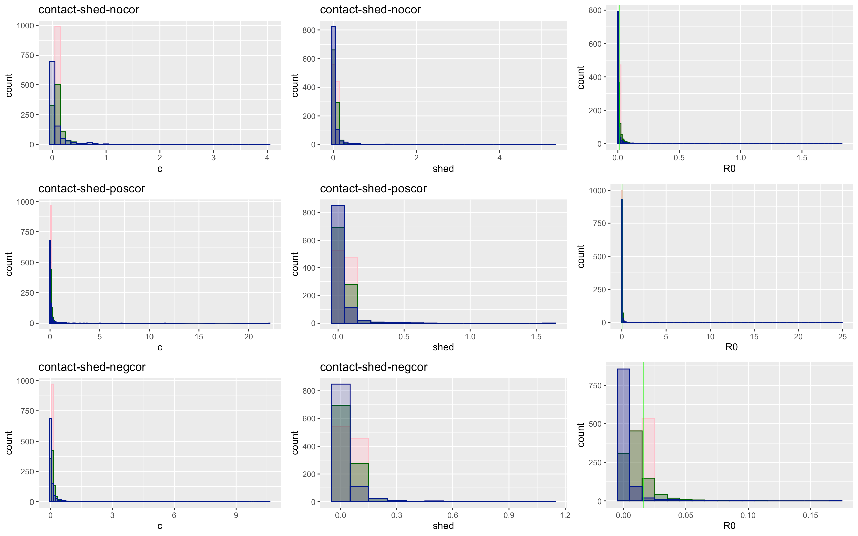
Notes:
Blue=hi variation
Green = medium variation
Pink = low variation
Green line is R0 from just mean values

Slide 2
Contact-shed | Low | Medium | High
No Covariation
Total | 137218 | 128703 | 21965
Proportion of 0 infections | 0.513 | 0.623 | 0.827
Mean/median secondary infection | 2.05 / 2 | 2.64 / 2 | 5.7 / 2
Positive Covariation
Total | 138846 | 147533 | 61908
Proportion of no infections | 0.514 | 0.670 | 0.861
Mean/median secondary infection | 2.05 / 2 | 3.02 / 2 | 7.17 / 2
Negative Covariation
Total | 136676 | 108204 | 1178
Proportion of no infections | 0.507 | 0.582 | 0.795
Mean/median secondary infection | 2.02 / 2 | 2.39 / 2 | 3.643 / 2

Slide 3
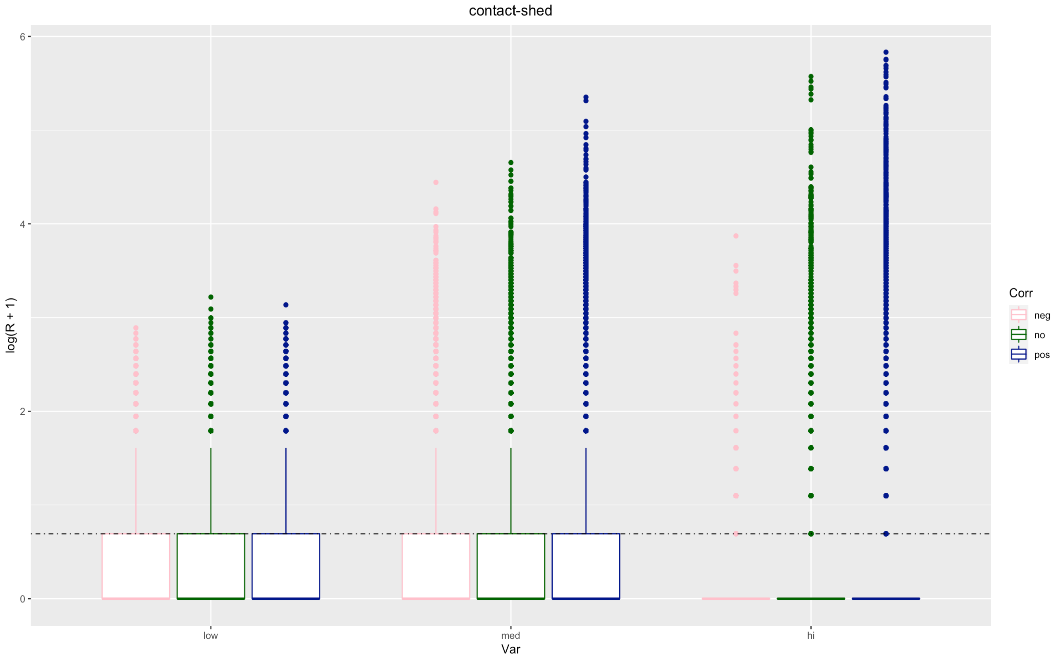

Slide 4
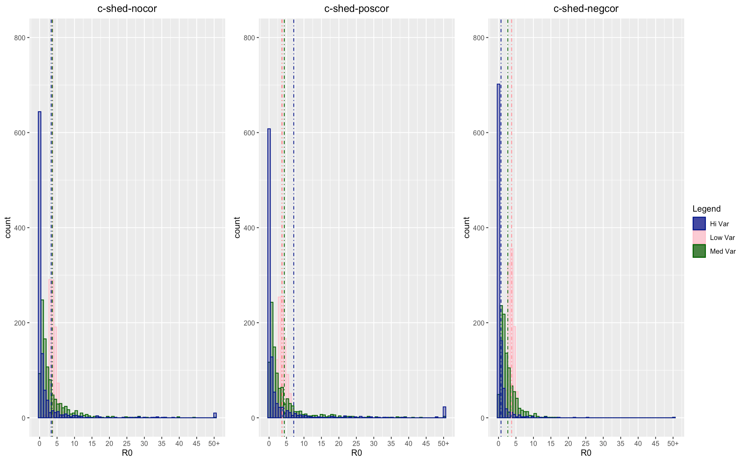

Slide 5
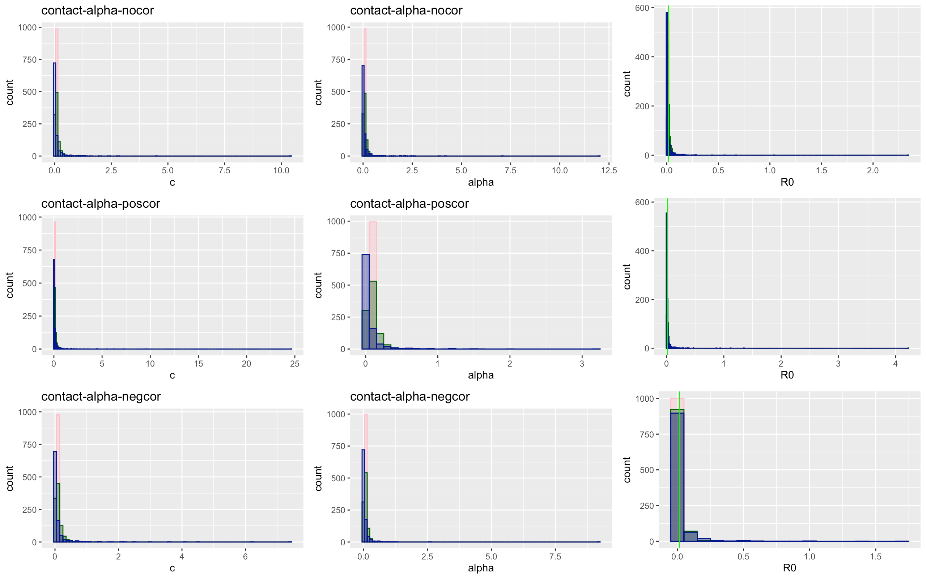

Slide 6
Contact-alpha | Low | Medium | High
No Covariation
Total | 137462 | 128172 | 95958
Proportion of 0 infections | 0.5048232 | 0.5777081 | 0.7326122
Mean/median secondary infection | 2.01 / 1 | 2.362 / 2 | 3.728 / 2
Positive Covariation
Total | 137805 | 127885 | 98910
Proportion of no infections | 0.5043504 | 0.579114 | 0.7460924
Mean/median secondary infection | 2.013162 / 1 | 2.370367 / 1 | 3.92 / 2
Negative Covariation
Total | 137178 | 133676 | 113970
Proportion of no infections | 0.5091414 | 0.6020078 | 0.7675704
Mean/median secondary infection | 2.032791 / 2 | 2.506973 / 2 | 4.291053 / 2

Slide 7
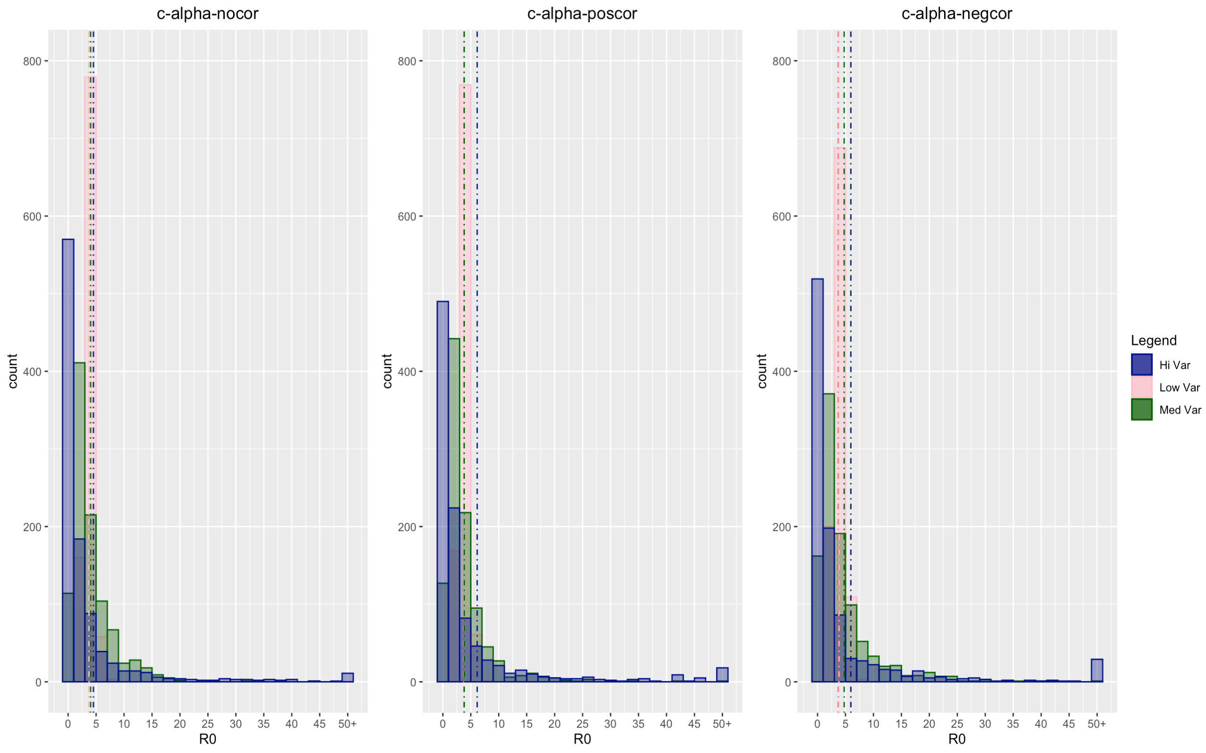

Slide 8
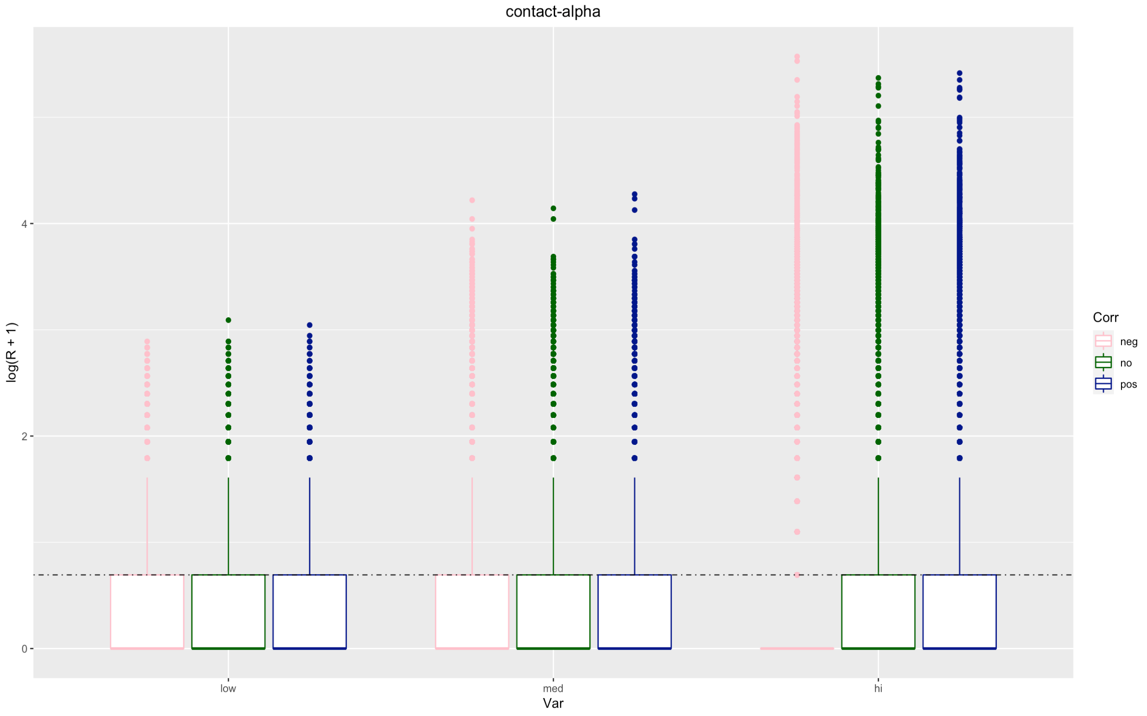

Slide 9
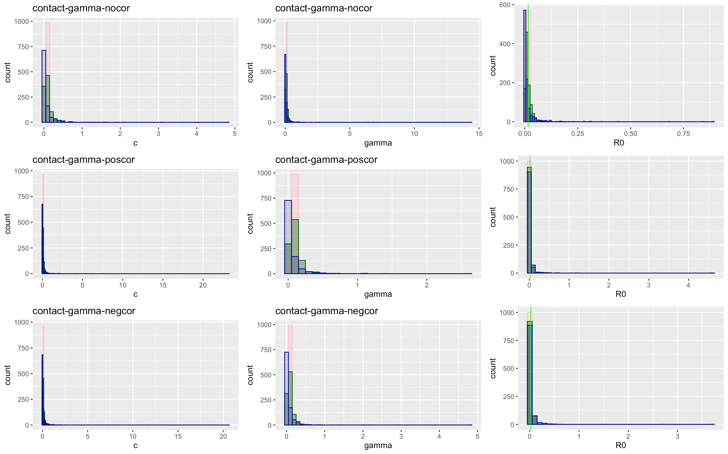

Slide 10
Contact-gamma | Low | Medium | High
No Covariation
Total | 138655 | 139496 | 112168
Proportion of 0 infections | 0.508 | 0.579 | 0.74
Mean/median secondary infection | 2.026 / 1 | 2.369 / 2 | 3.80 / 2
Positive Covariation
Total | 138007 | 143432 | 129929
Proportion of no infections | 0.507 | 0.578 | 0.751
Mean/median secondary infection | 2.026 / 2 | 2.366 / 1 | 4.00 / 2
Negative Covariation
Total | 138423 | 148732 | 163012
Proportion of no infections | 0.511 | 0.602 | 0.769
Mean/median secondary infection | 2.04 / 2 | 2.508 / 2 | 4.313 / 2

Slide 11
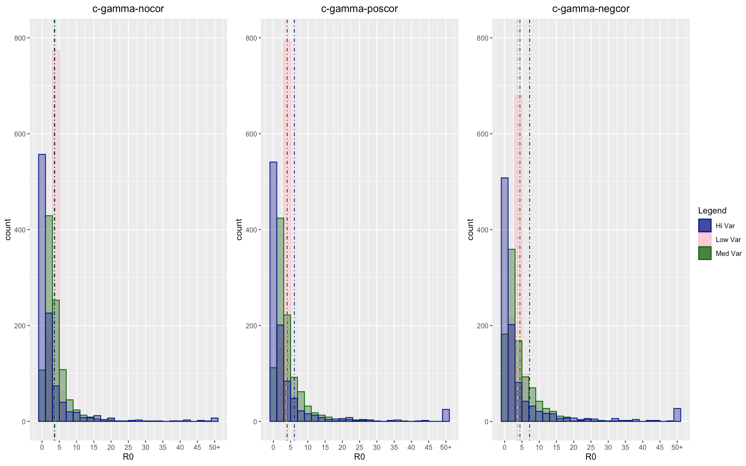

Slide 12
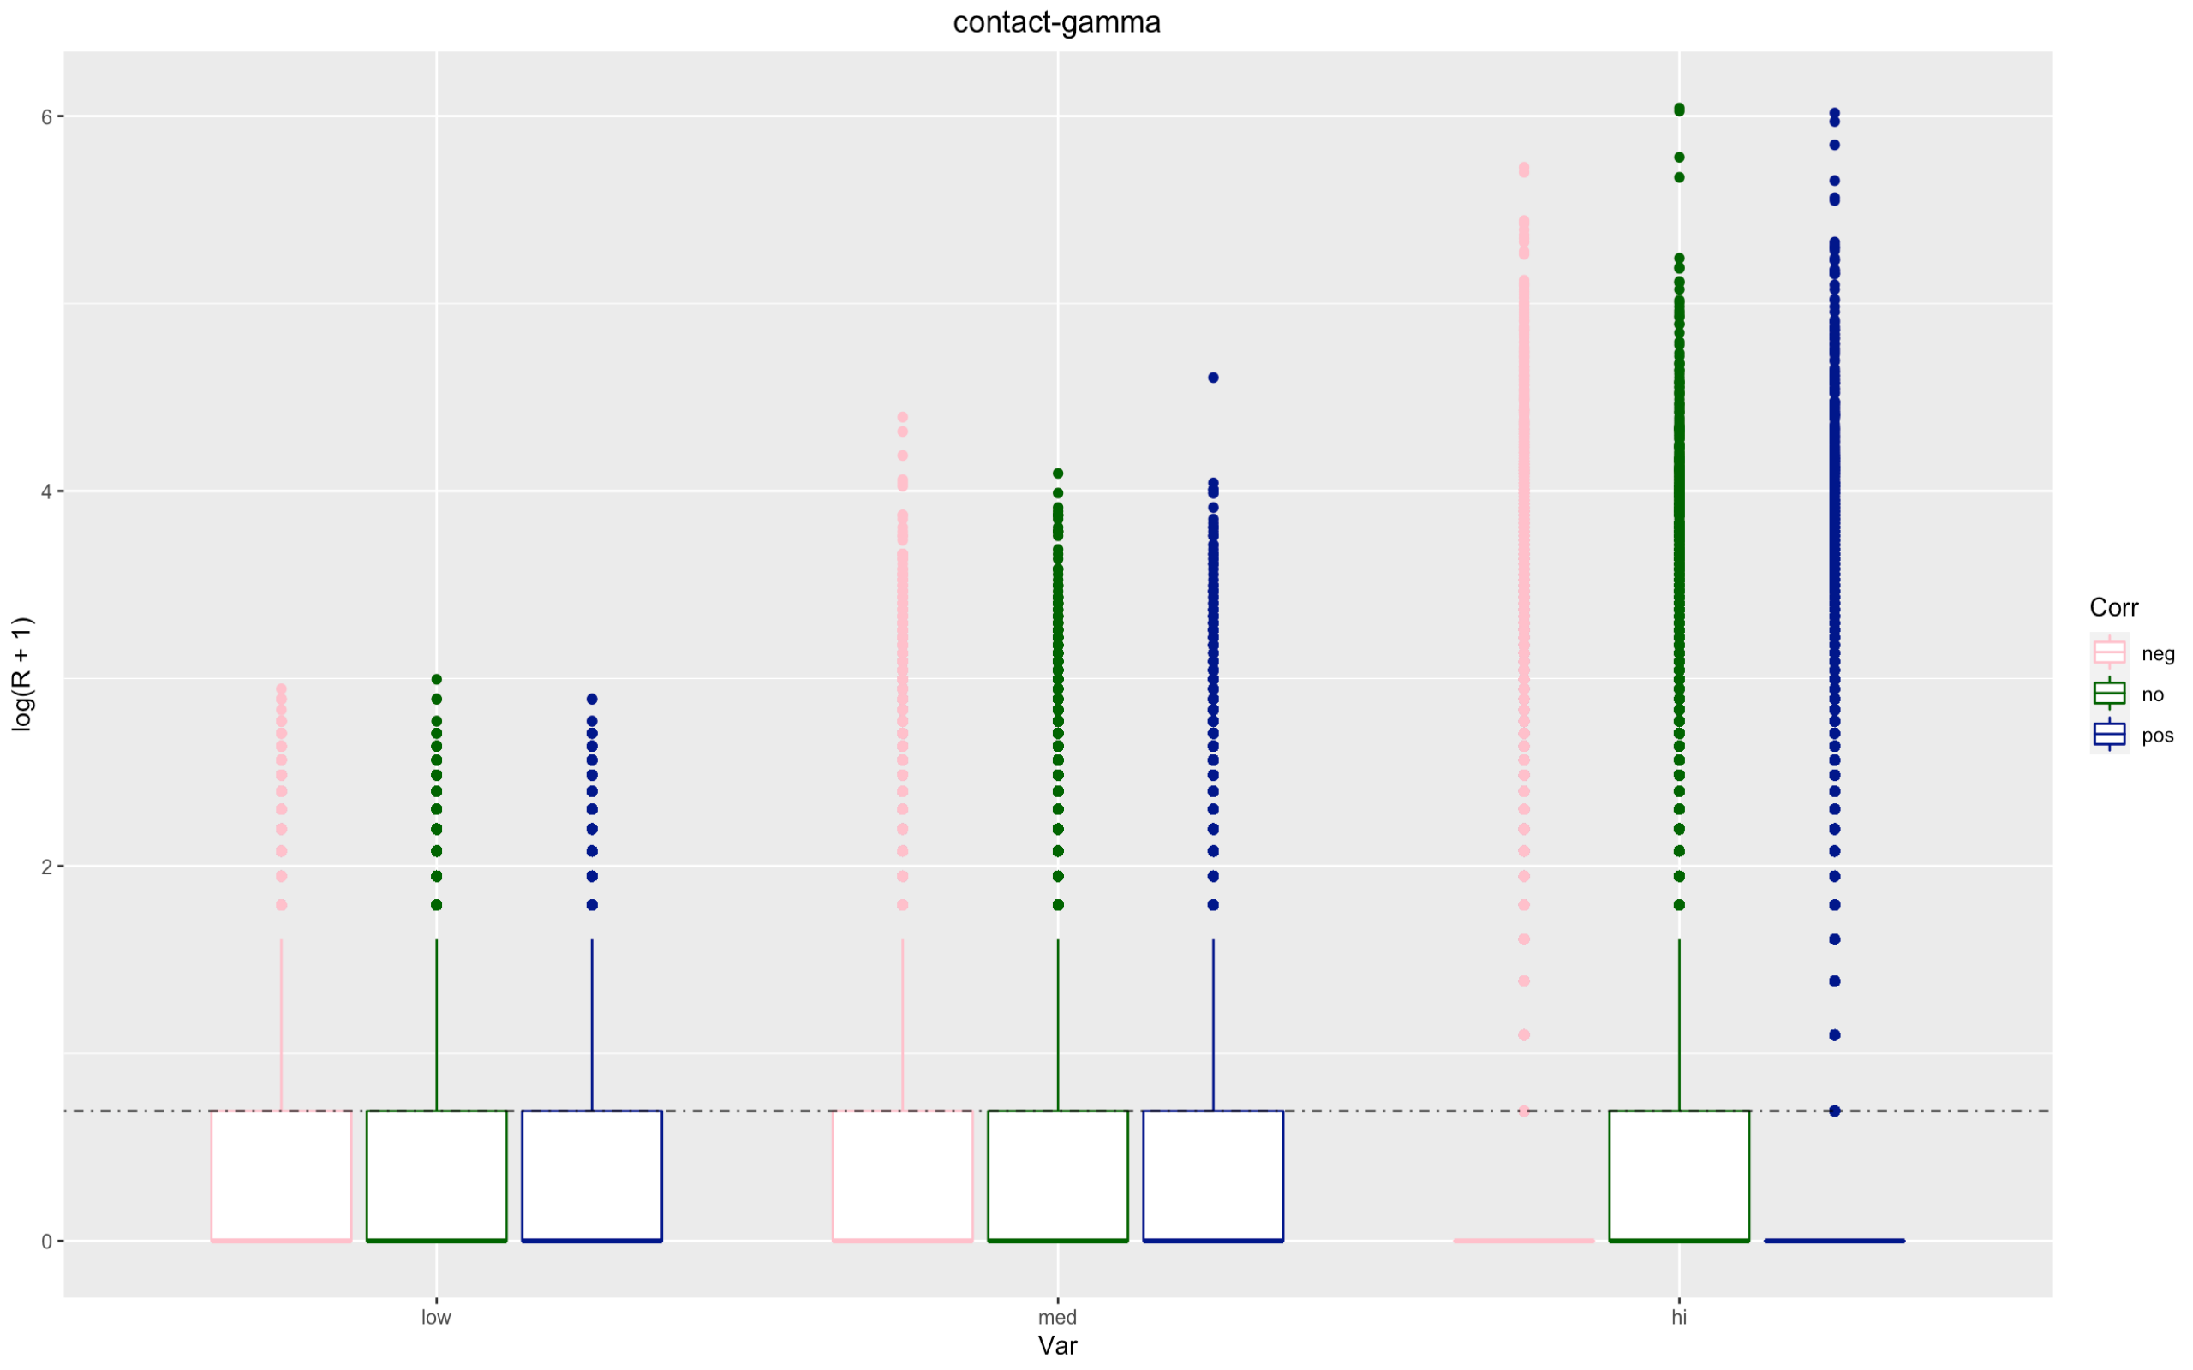

Slide 13
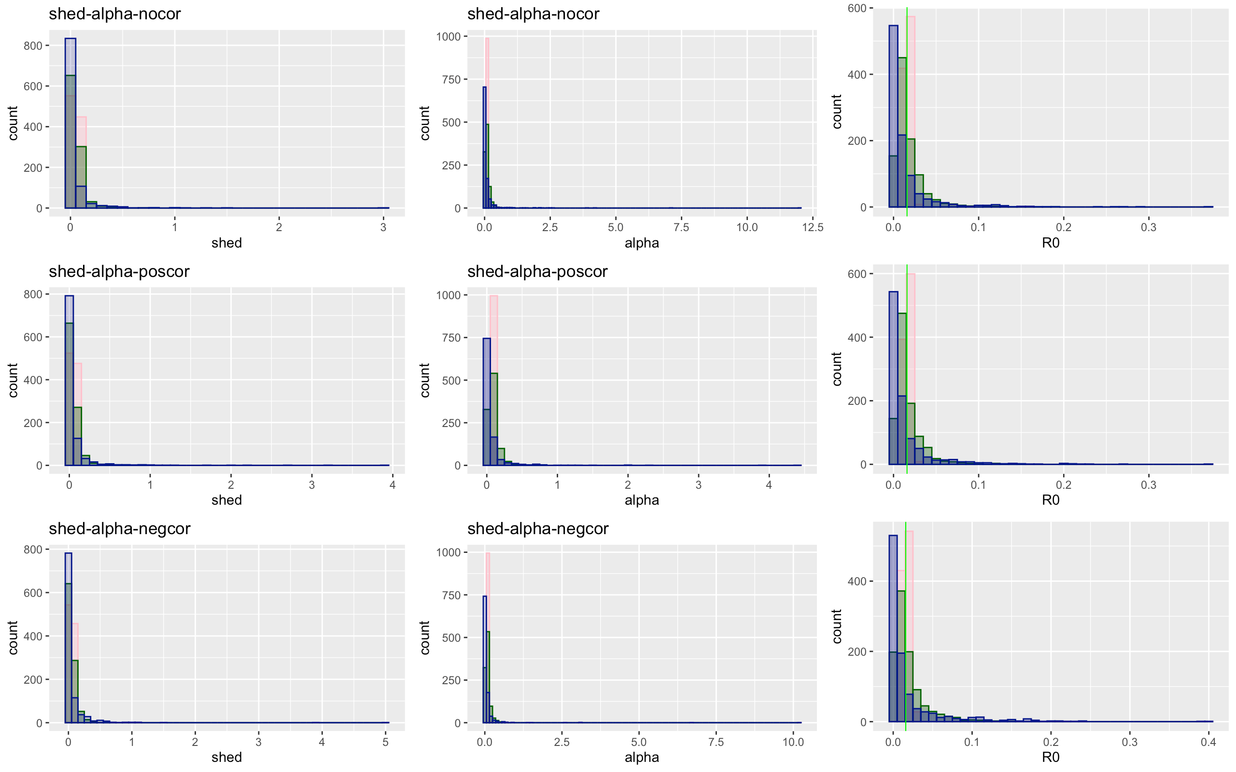

Slide 14
Shed - alpha | Low | Medium | High
No Covariation
Total | 137647 | 126587 | 86420
Proportion of 0 infections | 0.505 | 0.570 | 0.704
Mean/median secondary infection | 2.018 / 2 | 2.317 / 2 | 3.37 / 2
Positive Covariation
Total | 136852 | 128321 | 87554
Proportion of no infections | 0.506 | 0.569 | 0.7025
Mean/median secondary infection | 2.020 / 2 | 2.315 / 2 | 3.351 / 2
Negative Covariation
Total | 137482 | 131597 | 105400
Proportion of no infections | 0.507 | 0.589 | 0.726
Mean/median secondary infection | 2.024 / 1 | 2.43 / 2 | 3.63 / 2

Slide 15
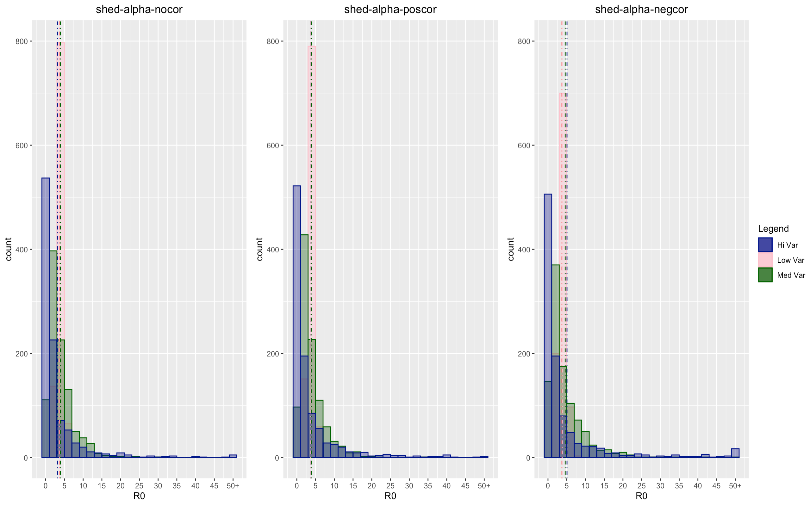

Slide 16
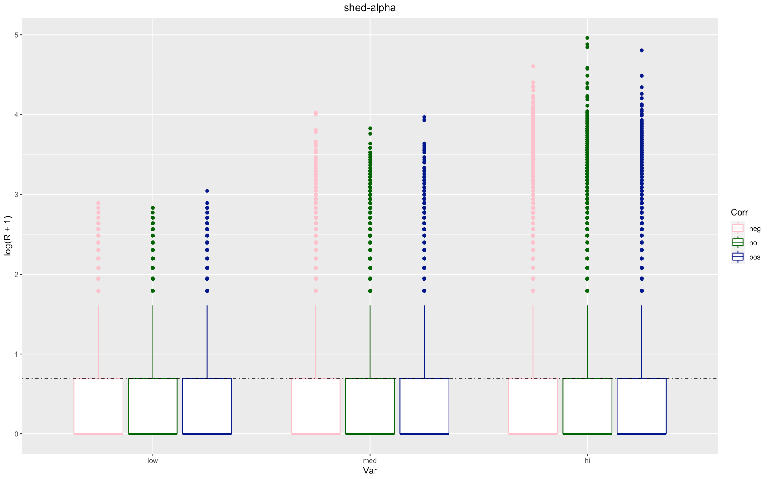

Slide 17
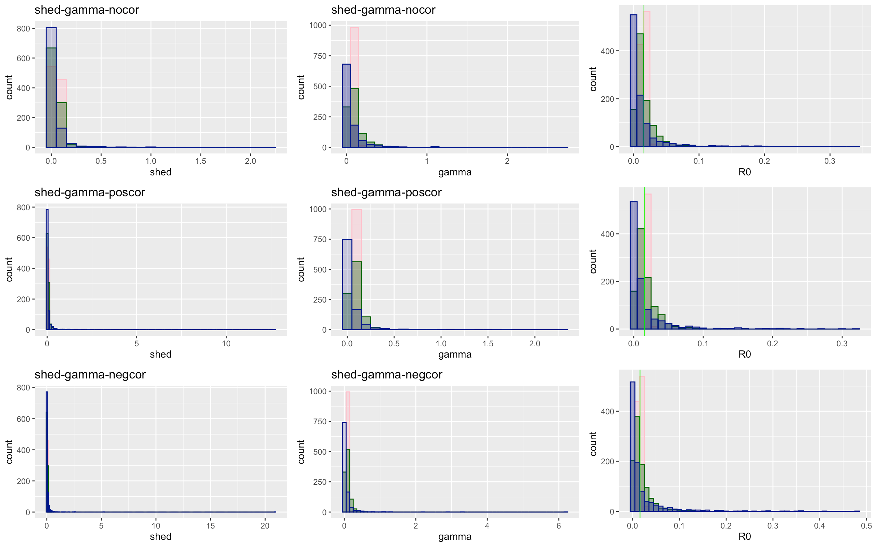

Slide 18
Shed - gamma | Low | Medium | High
No Covariation
Total | 138073 | 137687 | 110986
Proportion of 0 infections | 0.505 | 0.568 | 0.705
Mean/median secondary infection | 2.017 / 2 | 2.313 / 2 | 3.386 / 2
Positive Covariation
Total | 138498 | 138928 | 125219
Proportion of no infections | 0.504 | 0.570 | 0.705
Mean/median secondary infection | 2.013 / 1 | 2.318 / 2 | 3.382 / 2
Negative Covariation
Total | 138654 | 145770 | 132267
Proportion of no infections | 0.509 | 0.591 | 0.726
Mean/median secondary infection | 2.030 / 2 | 2.439 / 2 | 3.654 / 2

Slide 19
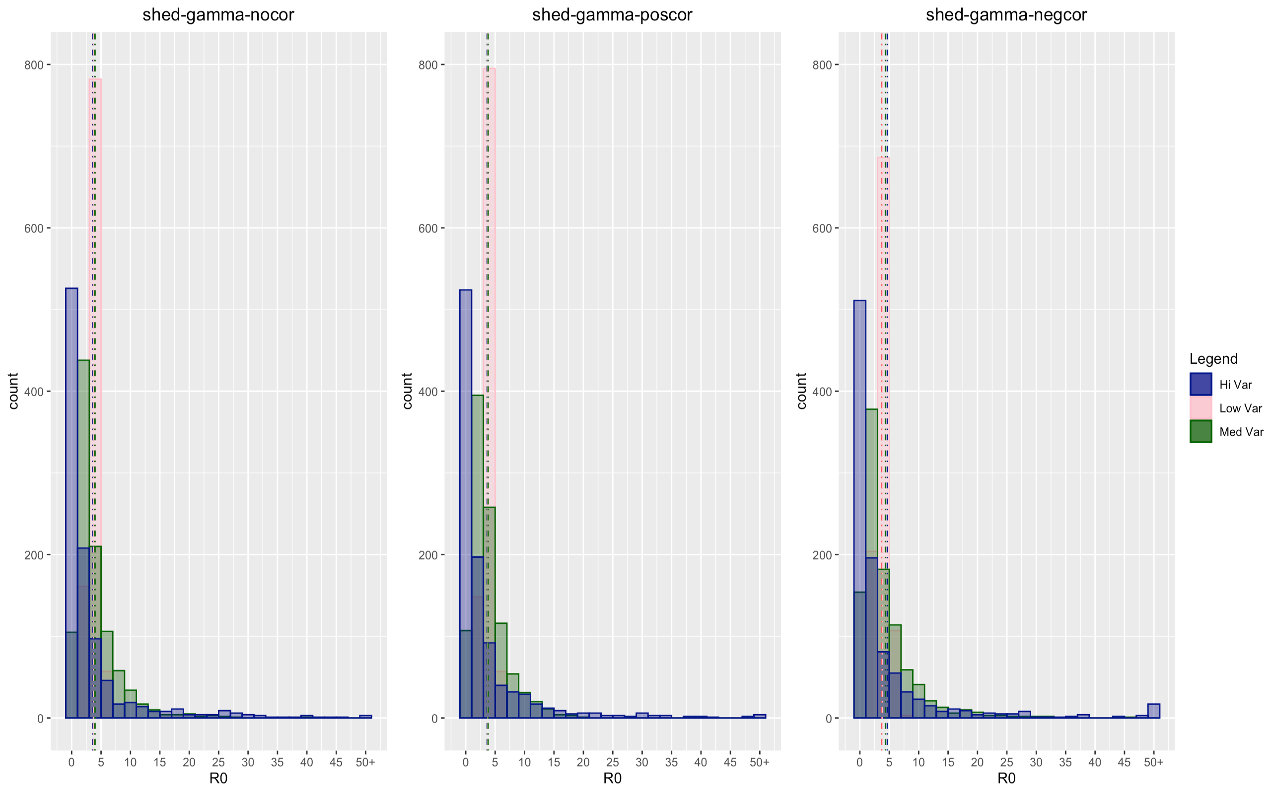

Slide 20
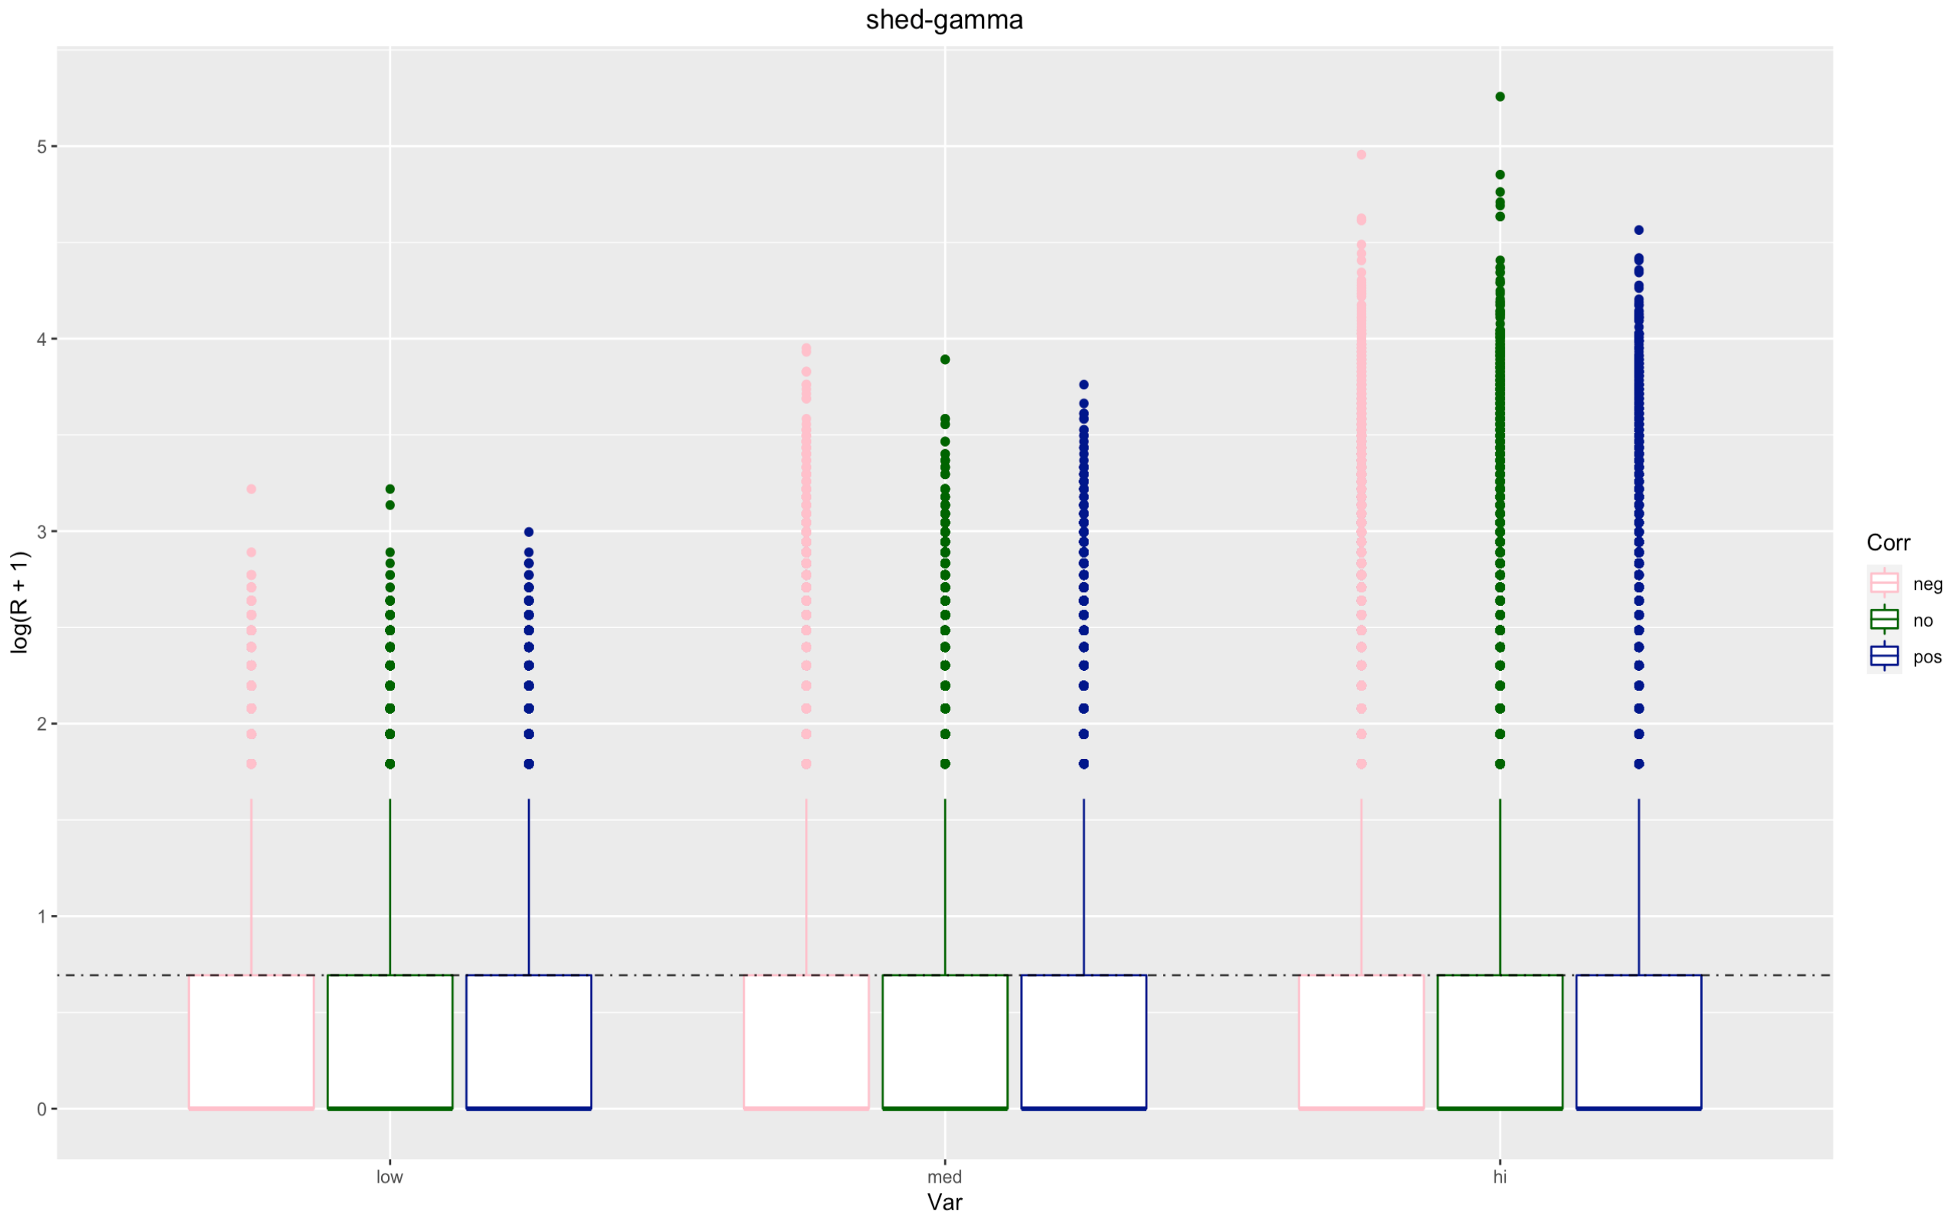

Slide 21
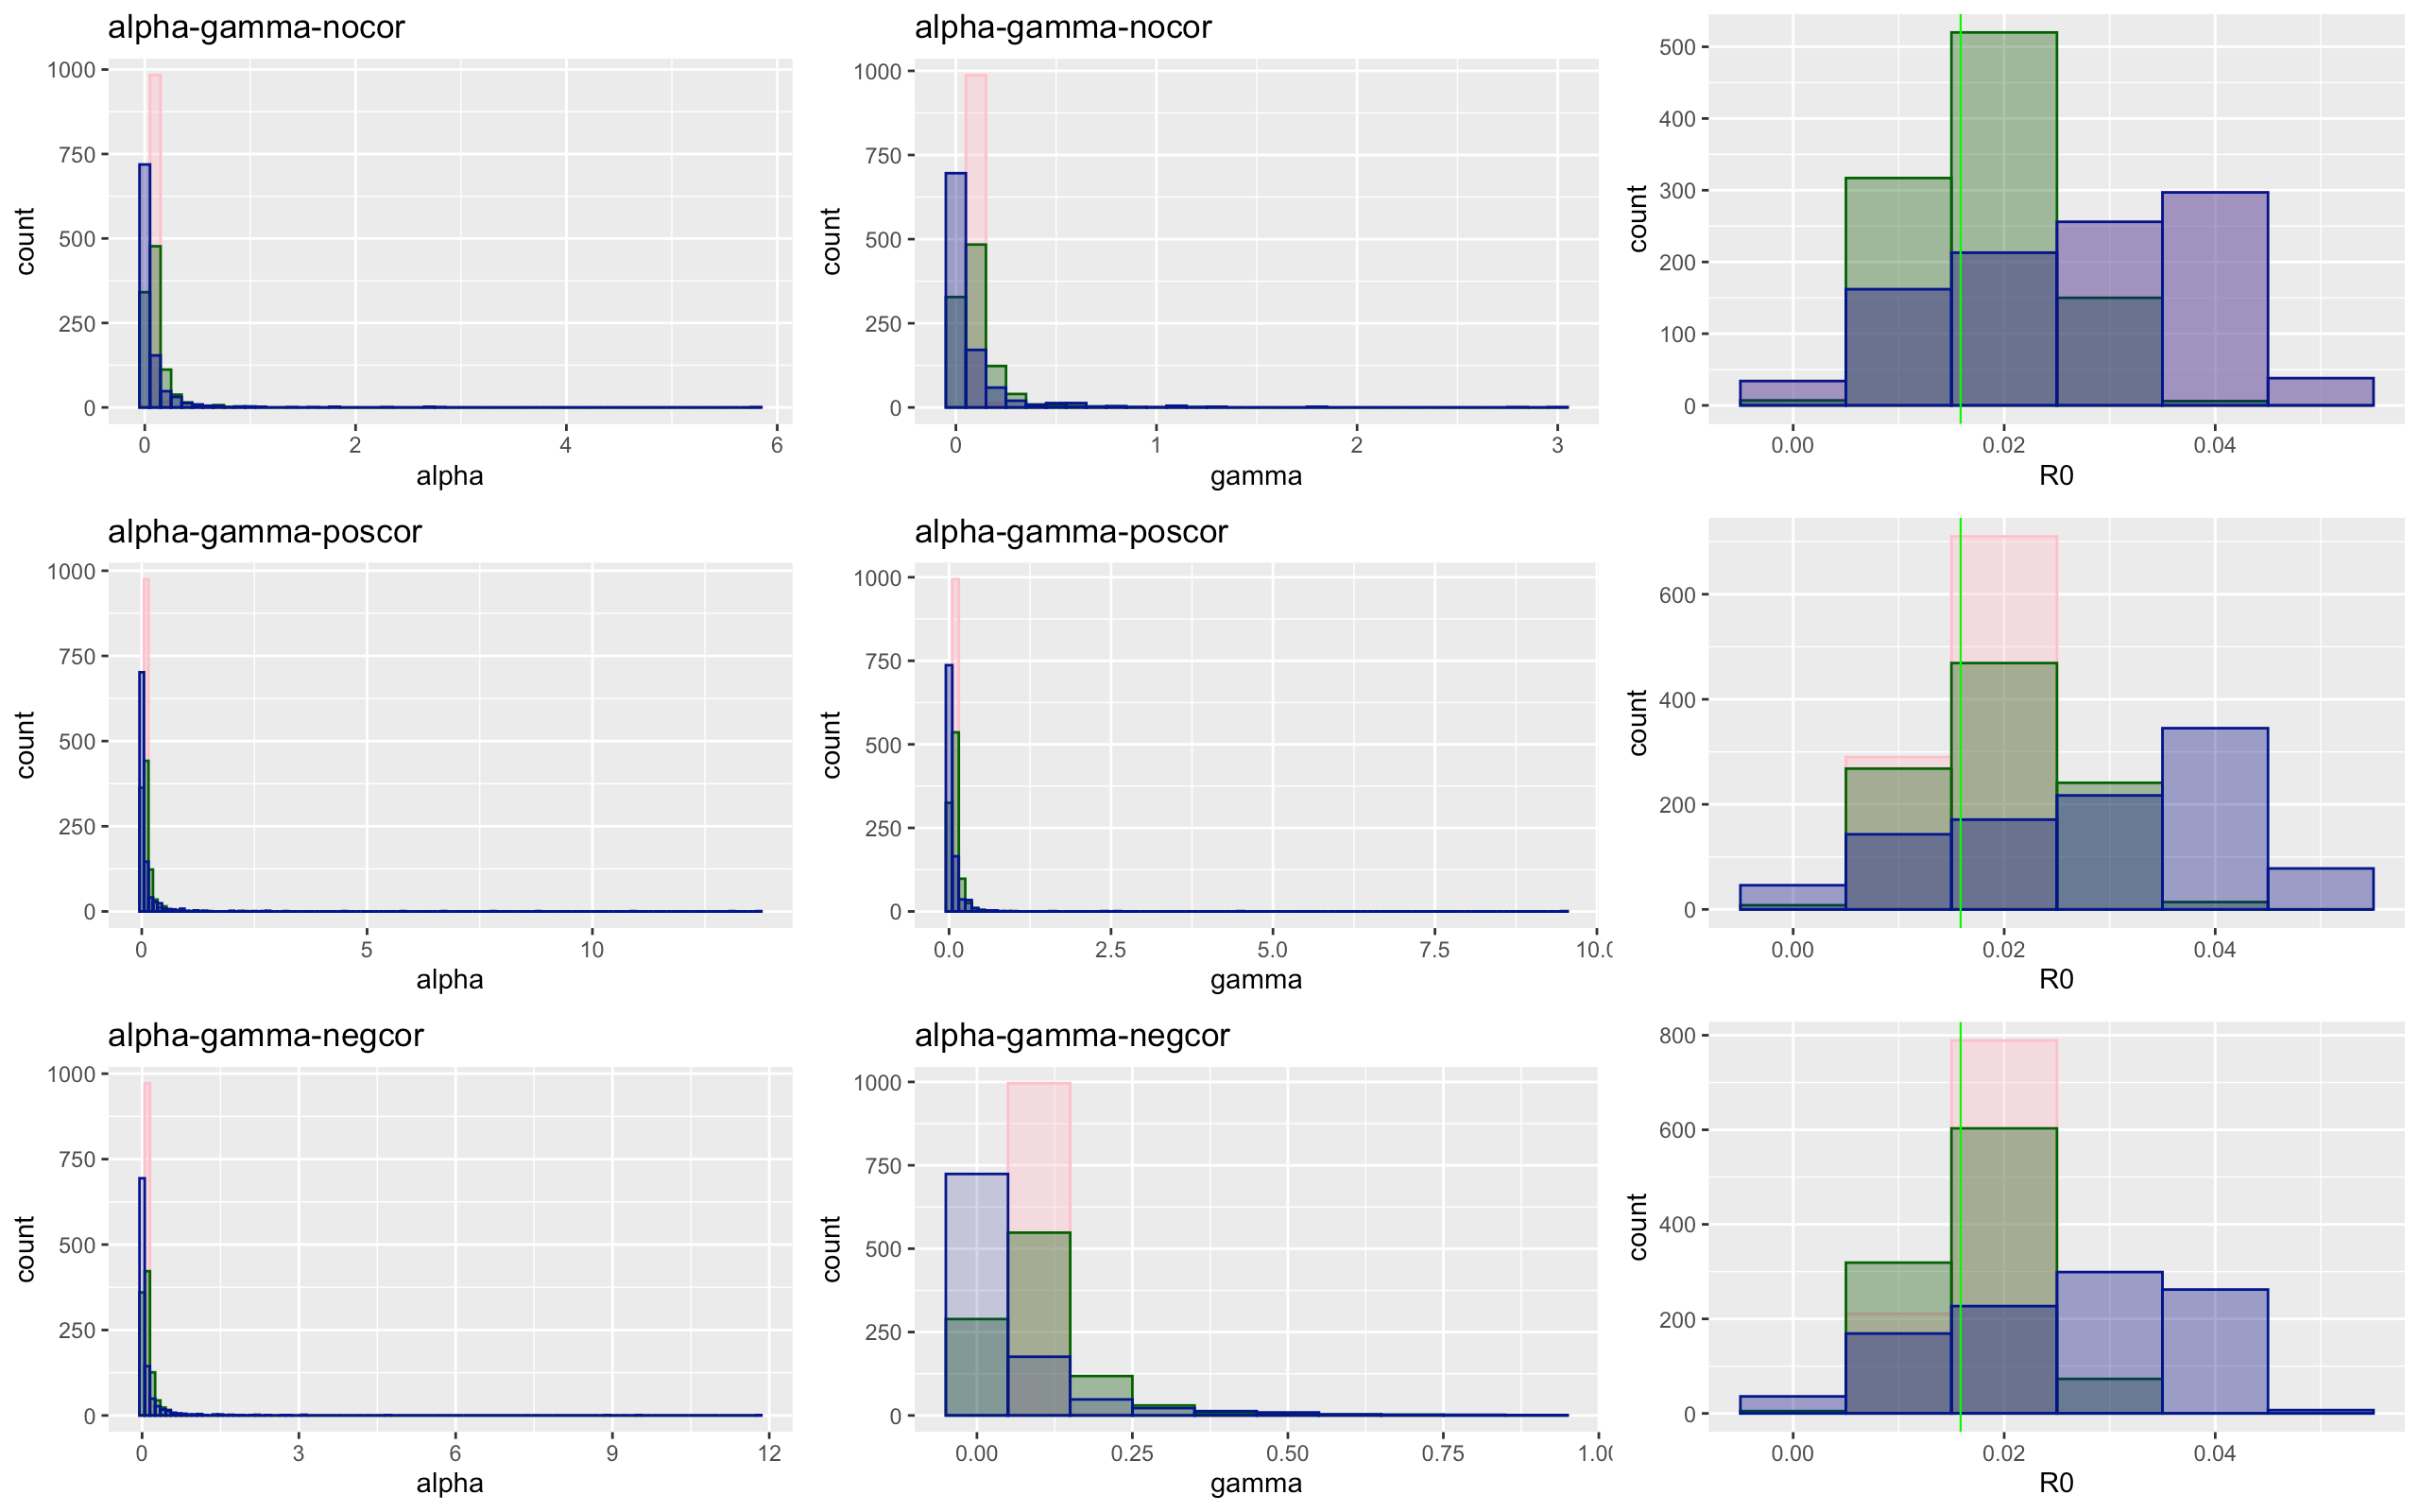

Slide 22
Alpha – gamma | Low | Medium | High
No Covariation
Total | 137637 | 138319 | 132893
Proportion of 0 infections | 0.502 | 0.513 | 0.530
Mean/median secondary infection | 2.005 / 2 | 2.049 / 2 | 2.123 / 2
Positive Covariation
Total | 134953 | 139547 | 137483
Proportion of no infections | 0.502 | 0.5172 | 0.527
Mean/median secondary infection | 2.002 / 2 | 2.067 / 2 | 2.109 / 2
Negative Covariation
Total | 137355 | 136998 | 139328
Proportion of no infections | 0.5019 | 0.512 | 0.5230
Mean/median secondary infection | 2.003 / 2 | 2.043 / 2 | 2.0919 / 2

Slide 23
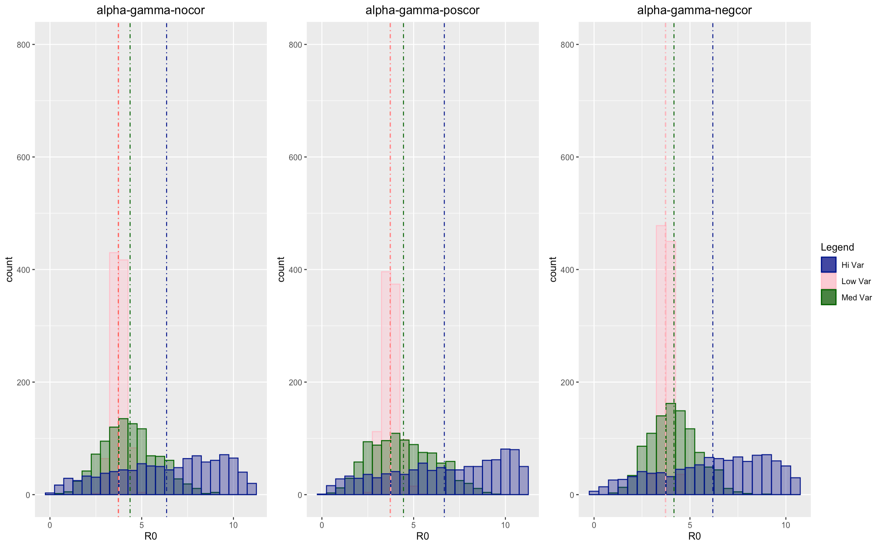

Slide 24
